Slide 1
Managing Public Records
for Local Government Employees
Records Analysis Unit
Government Records Section
Notes:
Welcome to Managing Public Records for Local Government Employees! My name is ______ and today I’m joined by my colleagues _____, who will take over about halfway through, and ______, who is keeping an eye out on the chat for us.
You should have already received a copy of the slides and a handout from Kayla. If you did not, check you spam folder. Kayla will send out those resources again following this workshop.
If you have any questions throughout the workshop you can use the Q&A feature. We’ll also be using the chat for activities.
If you have multiple people tuning in on one account, please list your names in the chat. This helps us keep accurate numbers for attendance.
You can request a certificate of attendance through our survey. We will share the link at the end of the workshop.
Without further ado, let’s begin!

Slide 2
Topics Covered
Public Records Law
Records Management Vocabulary
Retention Schedules
Active Records Management
Electronic Records
Notes:
Today’s workshop will have 5 sections:
Public Records Law
Records Management Vocabulary
Retention Schedules
Active Records Management
And Electronic Records

Slide 3
Public Records Law
Notes:
Let’s start out with a quick overview of public records law in North Carolina.

Slide 4






§ 132
Notes:
You may be sitting there thinking, “why do I need to know about public records law – just tell me what to do.”
And we completely understand that, but a basic understanding of the laws in place can help you as you make decisions in your records management.

Slide 5
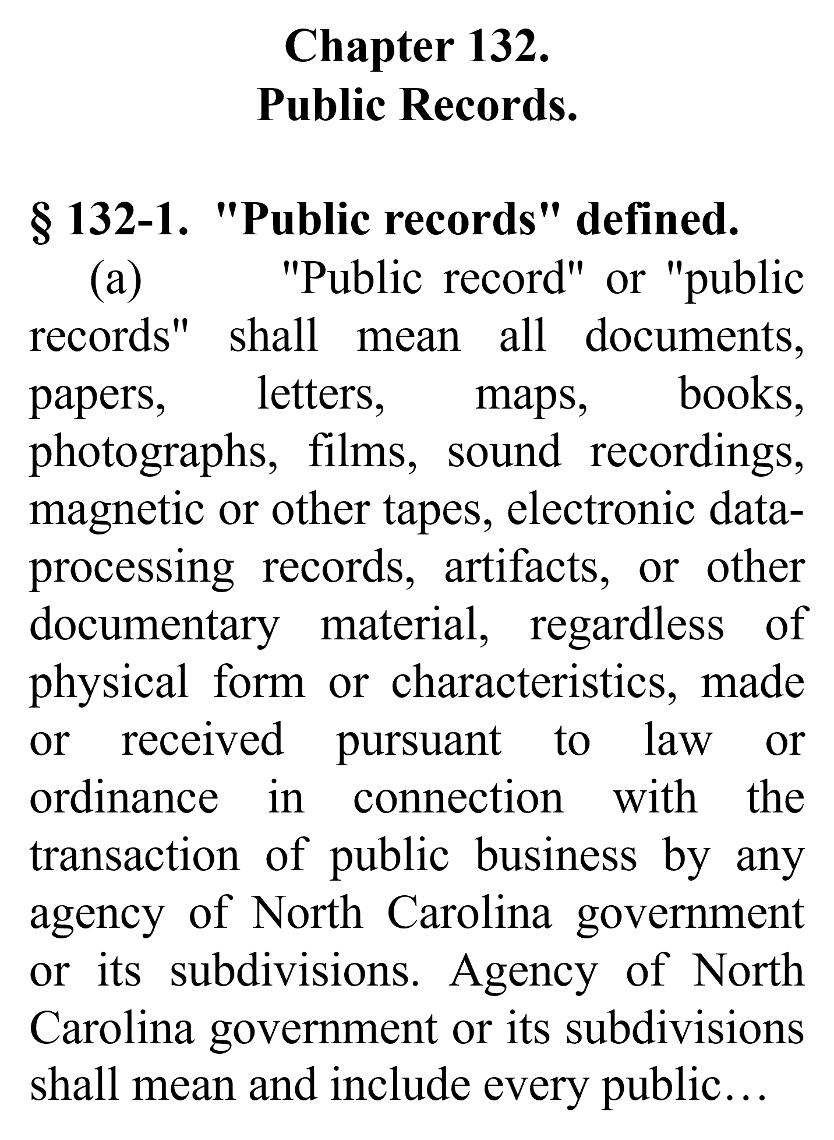









G.S. 132-1:
Public Record
Any record, regardless of format, that is created in the transaction of government business
Notes:
But first things first, what exactly is a public record?
Well, in North Carolina, the definition of a public record can be found in General Statute 132-1. It defines a public record as any record, <CLICK> regardless of format, that is created in the transaction of government business.
This means that public records can be maps, text messages, documents, emails, photographs, videos, audio recordings, letters, and so much more

Slide 6


G.S. 132-1:
Public Record
Public records created on private devices are still public records
Public Record?
Notes:
It is also important to note that the law makes no distinction between personal and private devices.
​
So, if you are conducting government business on your personal device, you are still creating public records and they are still subject to public records requests. It’s best to use work-issued devices or accounts whenever possible to help keep work and personal matters separate

Slide 7
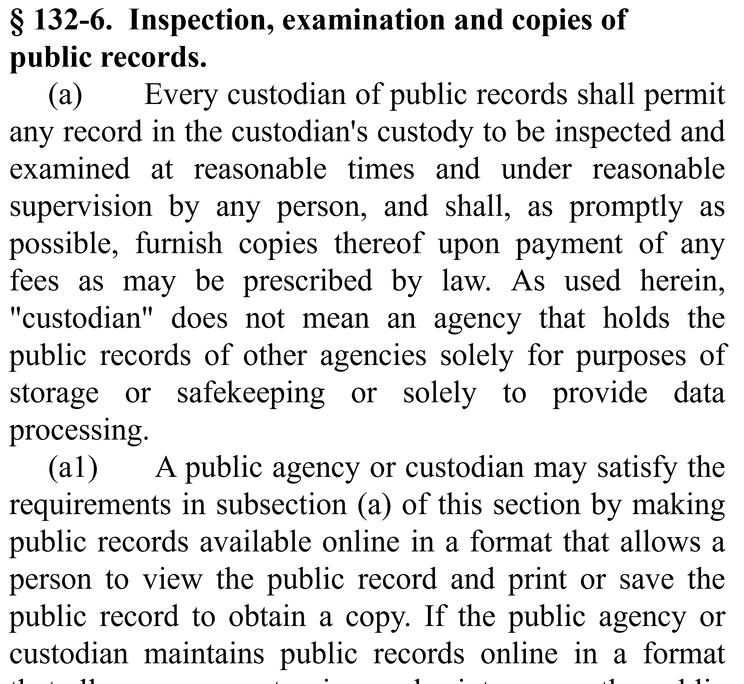
G.S. 132-6: Public Records Requests
Notes:
Which brings us to G.S. 132-6, the statute that outlines your responsibilities for public records requests. According to this statute, records requests must be <CLICK> answered at reasonable times, which means that you aren’t going to need to come into the office at 3am.
However, they must also be answered <CLICK> as promptly as possible.

Slide 8

G.S. 132-6:
Public Records Request
Explanation of Purpose
Fees for Inspection
Fees to Separate Confidential Information
Notes:
The statute includes additional stipulations regarding intention, fees, and confidentiality.
Firstly, no one is required to give a purpose or motive for their public records request. You are allowed to ask if you think it will help you fulfill the request, but they are not required to answer.
Second, you cannot charge for the inspection of records. If copies are requested, fees must be limited to material costs. However, if the request meets the criteria of G.S. 132-6.2(b), a special service charge may apply.
Lastly, you cannot deny a records request on the grounds that there is confidential information included within the records. The agency must instead bear the costs of separating or redacting the confidential information.
But what exactly counts as confidential information?

Slide 9


NC GS § 143-318.10
NC G.S. § 125-19
20 USC § 1232g
NC G.S. § 132-1.7
CONFIDENTIAL
42 USC § 1320d-6
NC GS § 132-1.2(c)
01 NCAC 05B. 0103
NC G.S. § 115D-29
NC G.S. § 115C-174.13(a)
NC G.S. § 70-18
NC G.S. § 132-1.10 (b)(5)
Notes:
In order for public records to be confidential in North Carolina, they must be made confidential by federal or state statute.
This means that if you are trying to claim that a record is confidential... <CLICK> you must be able to point to the law that makes it so.

Slide 10





Examples of Confidential Records
Notes:
Medical records, personnel files, prison records, student records, and blueprints for publicly owned buildings are some of the records that are confidential or contain confidential information.

Slide 11
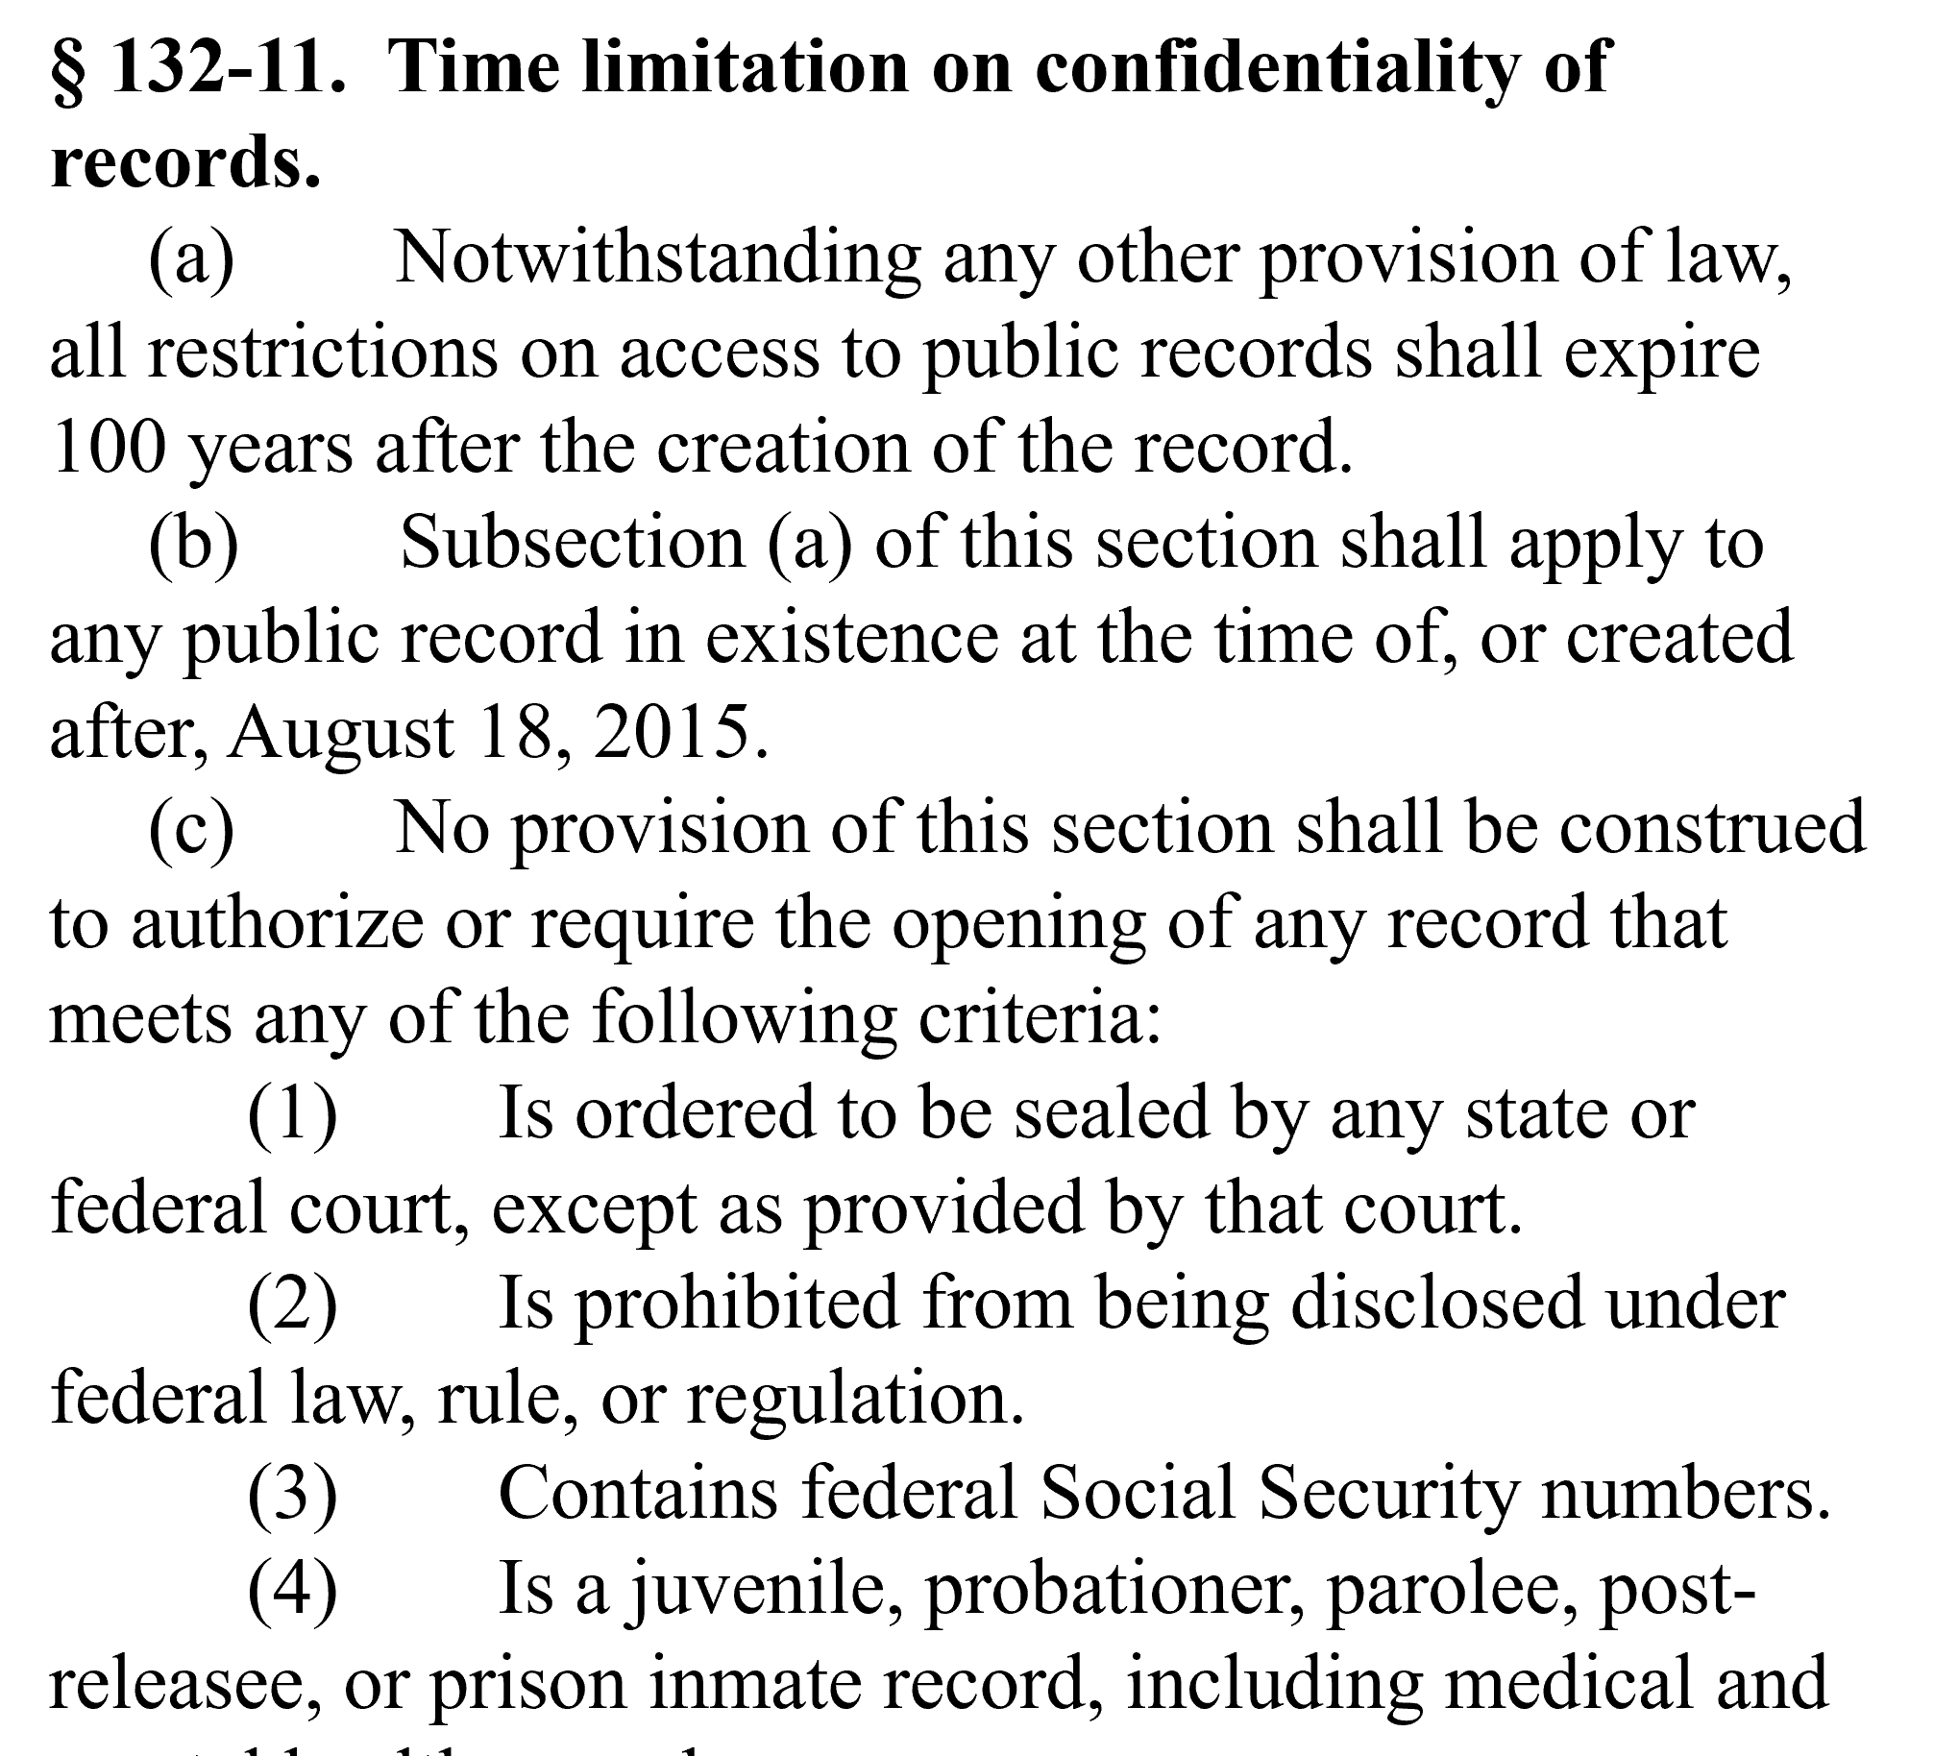
G.S. 132-11
Notes:
It’s important to note that according to General Statute 132-11, confidentiality for most records expires after <CLICK> 100 years.

Slide 12




07 NCAC 04M .0510
Records Destruction
Acceptable methods: burning, shredding, sell as wastepaper, pulping
Notes:
One last thing to consider regarding public records law is record destruction. The legal methods for destroying public records are defined in North Carolina Administrative Code 7.4.M.0510.
According to the administrative code. Public records can only be destroyed through the follow four methods:
Public records can be <CLICK> burned, unless prohibited by local ordinance
They can be <CLICK> shredded or torn up so as to destroy the content of the records so that they cannot be reconstructed.
You can sell the records as <CLICK> wastepaper. That’s what State Archives does. We have ours pulverized, pulped and turned into paper towels. If you choose this option, just make sure that the contract specifies that the records will be destroyed in such a way that they cannot be reconstructed.
The final way that you can destroy public records is through what we like to call the “breaking bad” method. In other words, you can use <CLICK> acid vats to reduce the paper to pulp.

Slide 13

07 NCAC 04M .0510
Records Destruction
For electronic records, the file and any associated metadata should be overwritten, deleted, and unlinked so that it cannot be reconstructed
Make sure ALL copies of the electronic record are destroyed
Notes:
Destruction of records also includes digital files.
In July 2014, the North Carolina Administrative Code was updated to explicitly incorporate electronic records. As you may know, deleting a file isn’t enough to erase it from your computer—all that does is give the computer permission to overwrite the information as needed. To destroy an electronic record, the actual data associated with the record (metadata) needs to be overwritten. Keep in mind as well that multiple copies of the same record may exist on different computers and that all of those copies need to be destroyed in accordance with the records schedule.

Slide 14
07 NCAC 04M .0510
Records Destruction
Confidential records should be destroyed in a way that the information cannot be reconstructed
“the provision that confidential records of any format are to be destroyed means the data, metadata, and physical media are to be destroyed in such a manner that the information cannot be read or reconstructed under any means.”
-07 NCAC 04M .0510 (c)
Notes:
Confidential records, such as medical records and charts, must be destroyed so that they cannot be practicably reconstructed, according to NCAC.
For paper records, shred and then recycle into waste paper, paper towels, etc., or pulp. To do this, you want to discard all documents and records into secure shredding/recycling bins. No paper should be thrown into garbage cans and you may want to consider the removal of garbage cans from records areas.
For electronic records, you’ll want to destroy the data and then go so far as to destroy the media on which the data was stored.
You’ll also want to train everyone on the process; audit the process periodically (once a year, etc.) to make sure that standards are maintained.

Slide 15

07 NCAC 04M .0510
Records Destruction
No destruction of records may take place if litigation, audits, or records requests are pending or reasonably anticipated
Notes:
Remember: ​If there’s an ongoing audit, a public records request, a lawsuit, or even a "reasonably anticipated" lawsuit, you may be required to retain records, including the metadata associated with electronic records, EVEN IF THEY COULD BE DESTROYED LEGALLY UNDER THE RETENTION RULES

Slide 16
QUESTIONS?
Notes:
Any questions so far?

Slide 17
Records Management Vocabulary
Notes:
Let’s continue our introduction to records management by covering some common terms you may encounter.

Slide 18










Notes:
As we mentioned before, public records consist of records created during the transaction of public business. However, not all public records are necessarily created equal.

Slide 19

Record Copy
Reference Copy
Transitory Record
Notes:
Typically, records fall into one of three categories: <CLICK>
Record Copies, Reference Copies, and Transitory Records.

Slide 20




Record
Reference
Transitory
  Original Or Official Copy
  Copy Intended For Easy Access To Information
  Minimal
  Intrinsic Value
Notes:
The Record Copy is the copy of a document, often the original, that is designated as the official copy for preservation. This is the copy that must be kept in accordance with the retention and disposition schedule, so it is important to designate the record copy of a document and its custodian. <CLICK>
Reference Copies, on the other hand, are duplicates of the Record Copy. They are made or kept for easy access to the information they contain. For example, if you print out an email, the email itself would be the record copy and the printout would be a reference copy. <CLICK>
Finally, Transitory Records are records that have little to no intrinsic or evidentiary value. They are typically destroyed immediately or only kept for a short period of time. Examples of transitory records include routing slips, transmittal sheets, catalogs, fax cover sheets, and drafts of other documents.

Slide 21
Essential Records
Records necessary for emergency response
Records necessary to resume or continue operations
Records that protect the health, safety, property, and rights of residents
Records that would require massive resources to reconstruct
Records that document the history of communities and families
Notes:
Essential records are another category that you may have heard used in conjunction with disaster preparation and response.
Essential records provide the agency with the information it needs to conduct business under abnormal conditions, and to resume more normal business after and event occurs. Keep in mind, that while all records are useful to the agency in some way; however, only a small percentage—typically less than five percent, government-wide—are essential. ​
Records are considered essential to your agency when they:​
Are necessary for emergency response
Are necessary to resume or continue operations
Protect the health, safety, property, and rights of citizens
Would require massive resources to reconstruct
Document the history of communities and families
If you want to learn more about essential records, we offer a whole workshop on the subject.

Slide 22
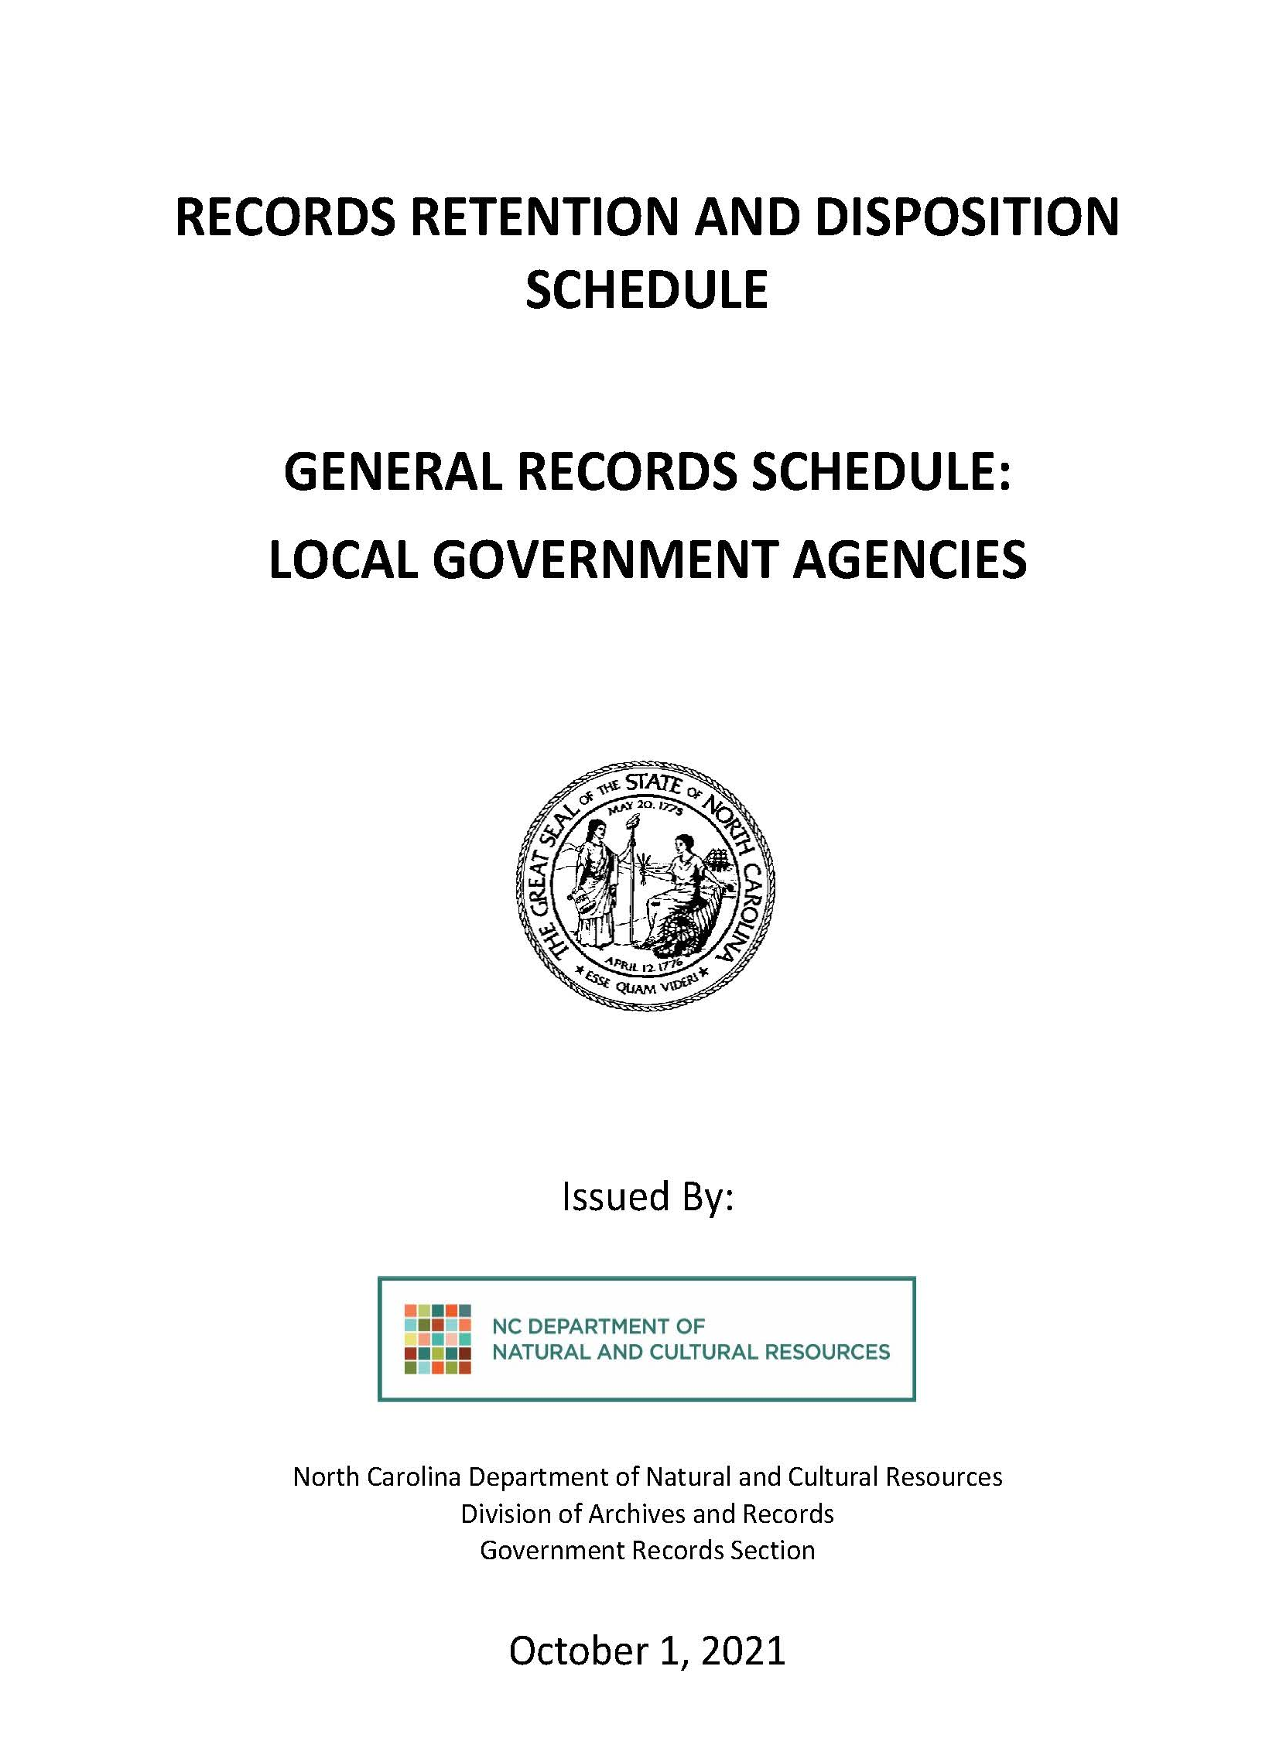
Record Retention and Disposition Schedules
What To Keep
For How Long
Notes:
You may have heard me mention Retention and Disposition Schedules when discussing record copies.
We’ll go into more detail in the next section, but for now just know that these schedules identify and describe an organization’s records and tell you... <CLICK> what to keep and for how long

Slide 23
QUESTIONS?
Notes:
Questions?

Slide 24
Retention Schedules
Notes:
In this next section, we’re going to focus on retention and disposition schedules and show you how to find and navigate them.

Slide 25
Creation
Active Use
Retention
Disposition
Disposition
Notes:
Retention Schedules walk you through the lifecycle of the record. Typically, a record is <CLICK> created, has <CLICK> a period of active use followed <CLICK> by required retention, <CLICK> then disposition.

Slide 26

Notes:
The record’s final outcome is usually either destruction or permanent preservation

Slide 27
Relevant Retention Schedules
General Records Schedule for Local Governments
Program Records Schedule for Local Governments
Notes:
Today, we are going to talk briefly about the two schedules that pertain to most local government agencies: ​
The General Records Schedule​ and
The Program Records Schedule
It is important to note that these schedules must be adopted by your governing board and a copy of the signature page sent to State Archives prior to any destruction taking place

Slide 28
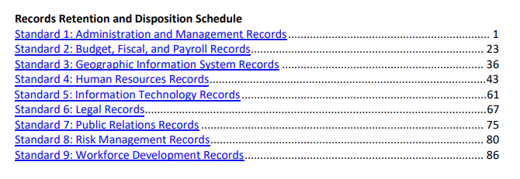
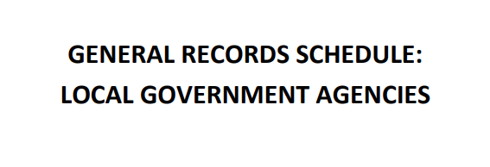
Notes:
The General Records Schedule includes 9 standards that are universal to most agencies with items related to records from administration, budget, HR, legal, etc. ​
I like to think of this as the base schedule.

Slide 29
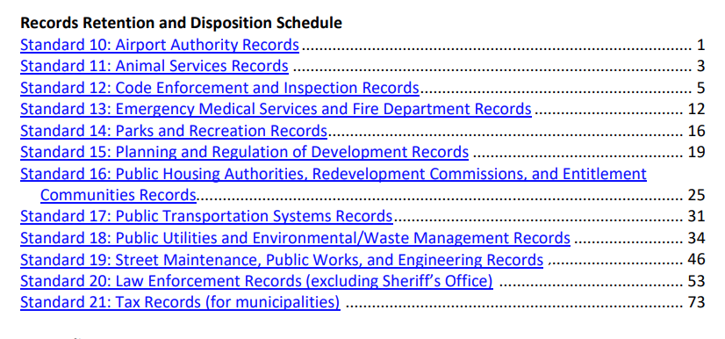
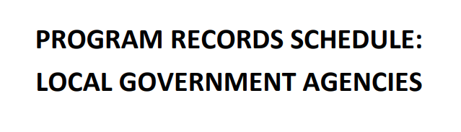
Notes:
The Program schedule builds off the first 9 standards of the General Records Schedule. ​For those of you who have been in local government for a while, it is a combination of the previous County and Municipal schedules with more specific standards like Code Enforcement, Parks and Rec, Public Utilities, and law enforcement records.
We encourage you to use the pdfs accessible on our webpage. You are certainly welcome to download and print, but today we plan to share the advantages of using the electronic version. So let’s take an in-depth look at how to find those pdfs

Slide 30
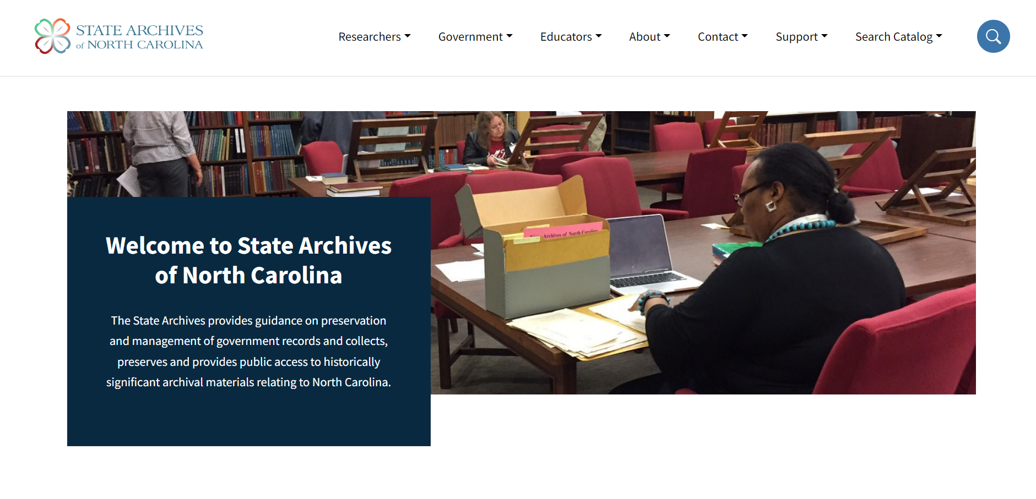
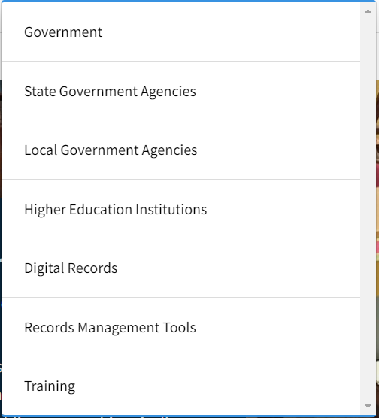
archives.ncdcr.gov
Notes:
We’ll start at the State Archives home page. We’ll then navigate to the government <CLICK> tab. This will open a drop down menu. <CLICK> As far as I am aware, everyone here today works for some sort of local government, so we’ll then click on the local government tab in the drop down menu <CLICK>.

Slide 31
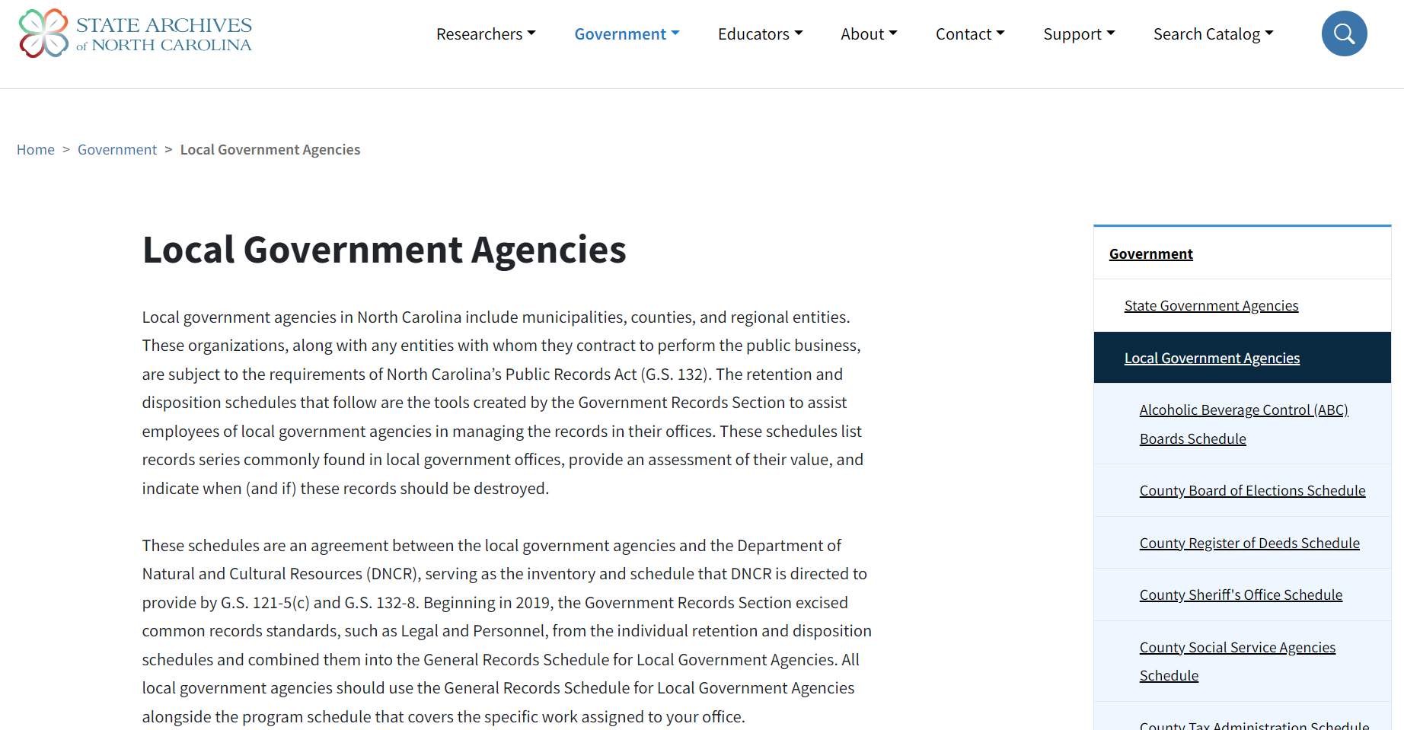
archives.ncdcr.gov/government/local
Notes:
This will bring us to the local government landing page, which will look something like what you see on the on the screen now. From there, you will scroll down until you see…

Slide 32
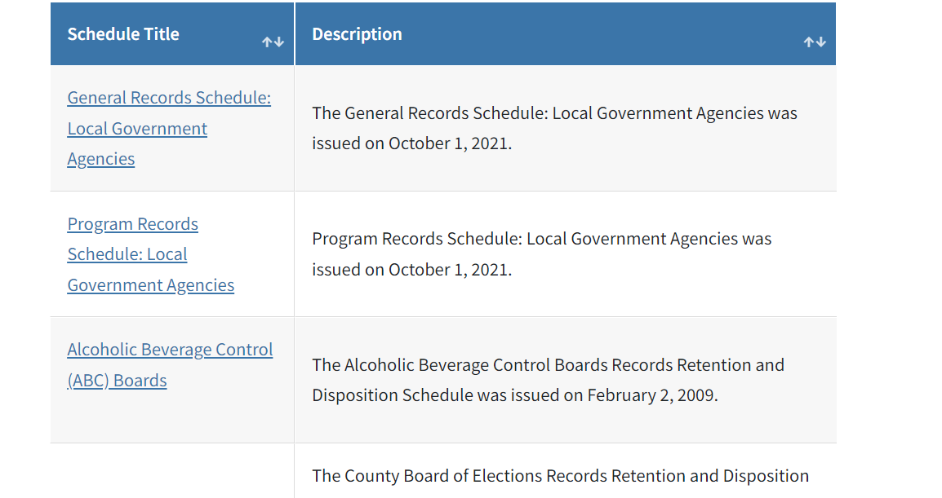
Notes:
…the table with links to the records schedule. Here you can see the <CLICK> General Records Schedule (which all local government employees will use) and <CLICK> the program records schedule.

Slide 33
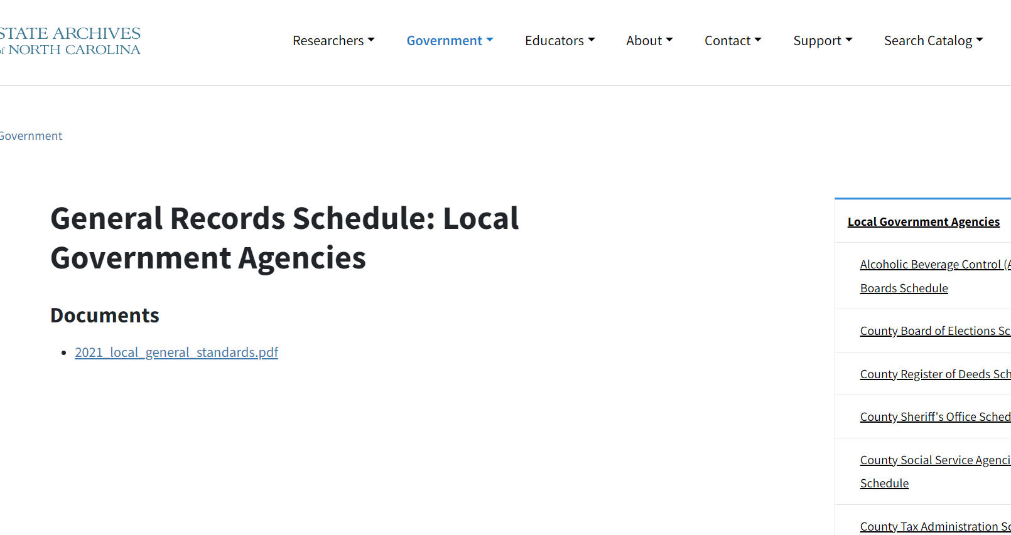
Notes:
Once you click on the schedule you want to open, in this case the general records schedule, you will find yourself on a landing page like this one. This is the page that we recommend you bookmark as this will be where updates and potential amendments to the schedules will be posted.

Slide 34
Notes:
So now that we know which schedules are relevant to us and how to find them, let’s take a look at how to read a retention schedule. We’ll use the general records schedule for this exercise.

Slide 35
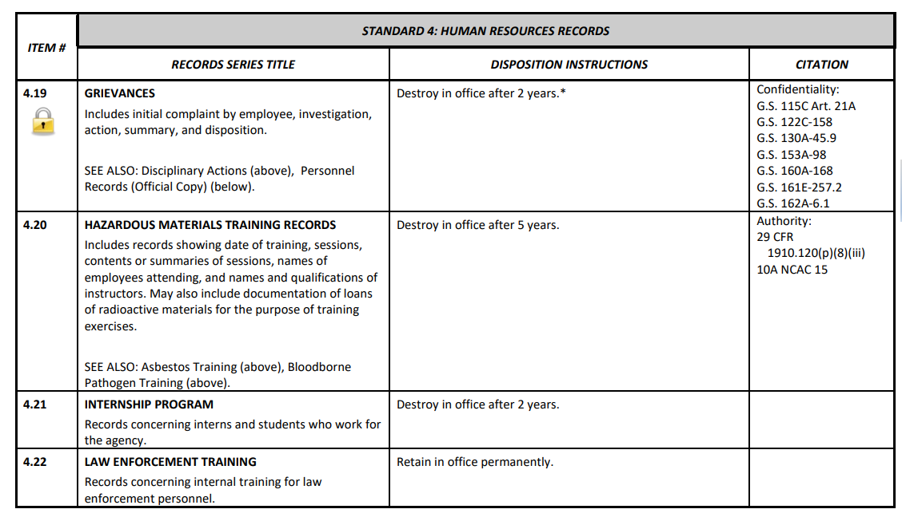
Notes:
​Here’s a page from Standard 4 of the General Schedule. It shows the typical table you’ll find on our retention schedules.

Slide 36
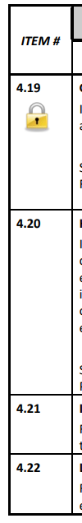
Notes:
The Item Number is the identifying number assigned to each record type to be used for ease of reference.

Slide 37
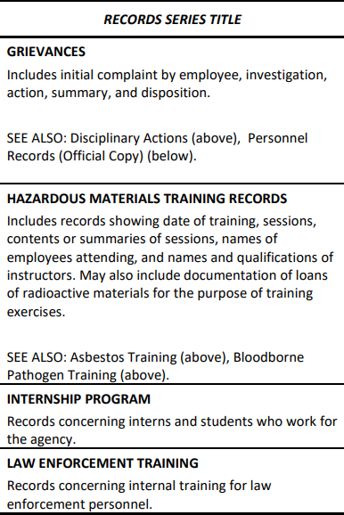
Notes:
The records series is a group of similar records that are arranged according to a filing system and that are related as the result of being created, received, or used in the same activity. Here you will find both the name of the series as well as a brief description of the records typically found within that series​

Slide 38
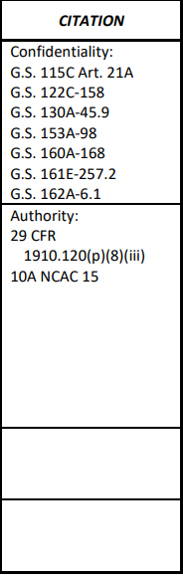

Notes:
We’re going to come back to the disposition instructions in a second and skip ahead to the citation section. This section references statutes, laws, and codes related to each type of record. <CLICK> the padlock icon you see under the item number is another way that we notate on the schedule that one or more records in this series may be confidential or may include confidential information.

Slide 39
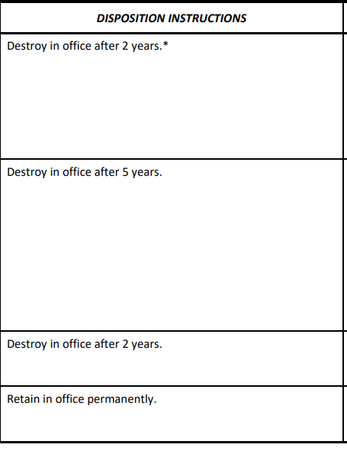
Notes:
Finally, the Disposition Instructions provide the length of time you need to keep records before dispose of records.​

Slide 40


Disposition Instructions:
Retention Indicators
RECEIVED​
APR 28 2015​
Closed
Completed
Entered
Execution of Plan
Received
Reference Values Ends
Scanned
Service Ends
Superseded or Obsoleted
COMPLETED​
DEC 24 2014​
Notes:
So let’s talk about when retention starts. Different actions can start the retention period.
The retention indicator, or what begins the retention should be clear for everyone in your office. And you should be consistent throughout your office and then proceed to records disposition at the appointed time whether that’s destruction or transferring the records.
Because remember, if there is a public records request for a record still in your office (even if that record is eligible for destruction), you have to present the record.

Slide 41
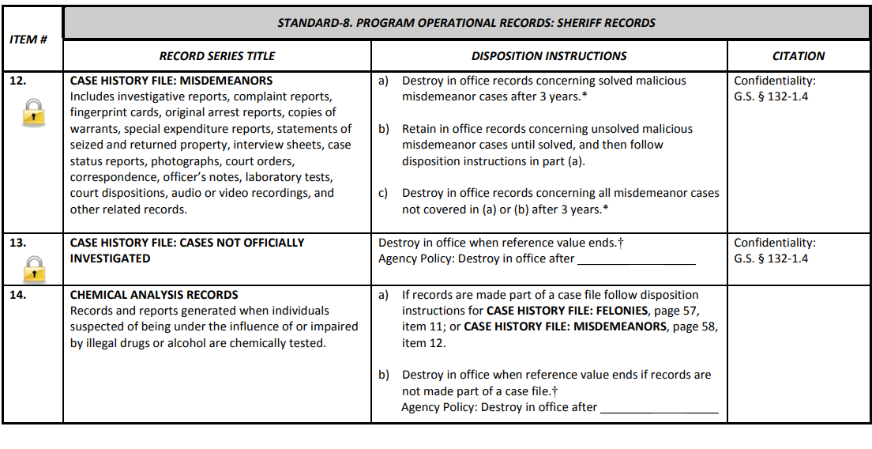

Notes:
Occasionally, in all of these schedules, you will see that this disposition section instructs you to destroy the records in office when the reference value ends. I wanted to bring this to your attention because <CLICK> you can see that there is a blank that needs to be filled in.
​
Local government agencies must establish and enforce internal policies setting minimum retention periods for records with the disposition instruction “destroy when reference value ends.” Without the establishment of these policies, the office is not authorized by the Department of Natural and Cultural Resources to destroy these records.​

Slide 42
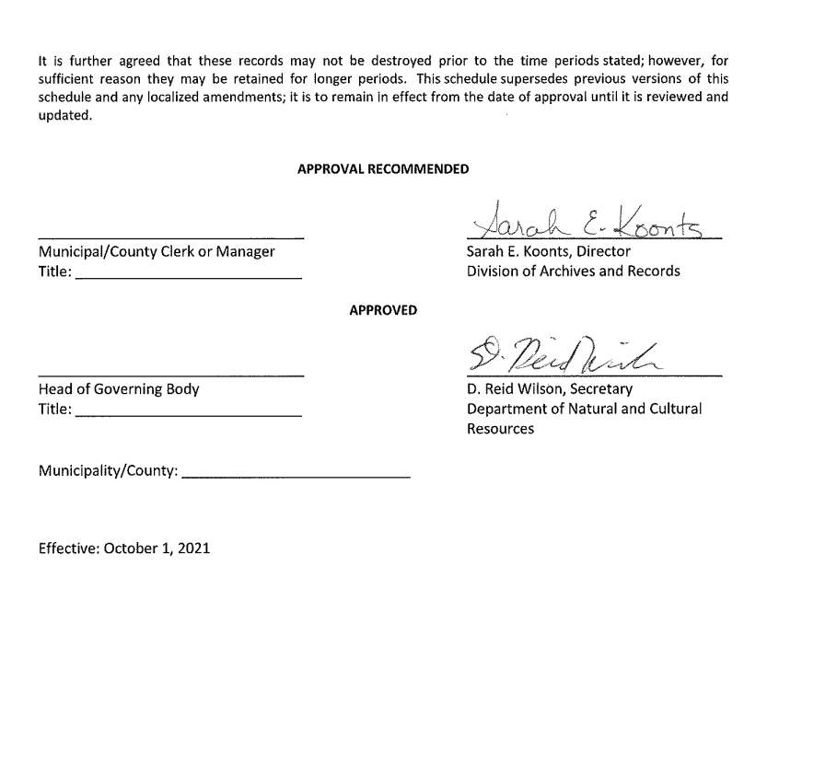
Notes:
Ideally the setting of those timeframes will be done prior to the adopting of the schedule by your governing body. Each local schedule has a signature page like the one you see on the screen. Legally, before any public record destruction can take place, you need to complete the signature page, gain approval of the governing body and have that approval noted in your minutes, and then send an electronic copy of the signature pages to a record analyst at State Archives.

Slide 43
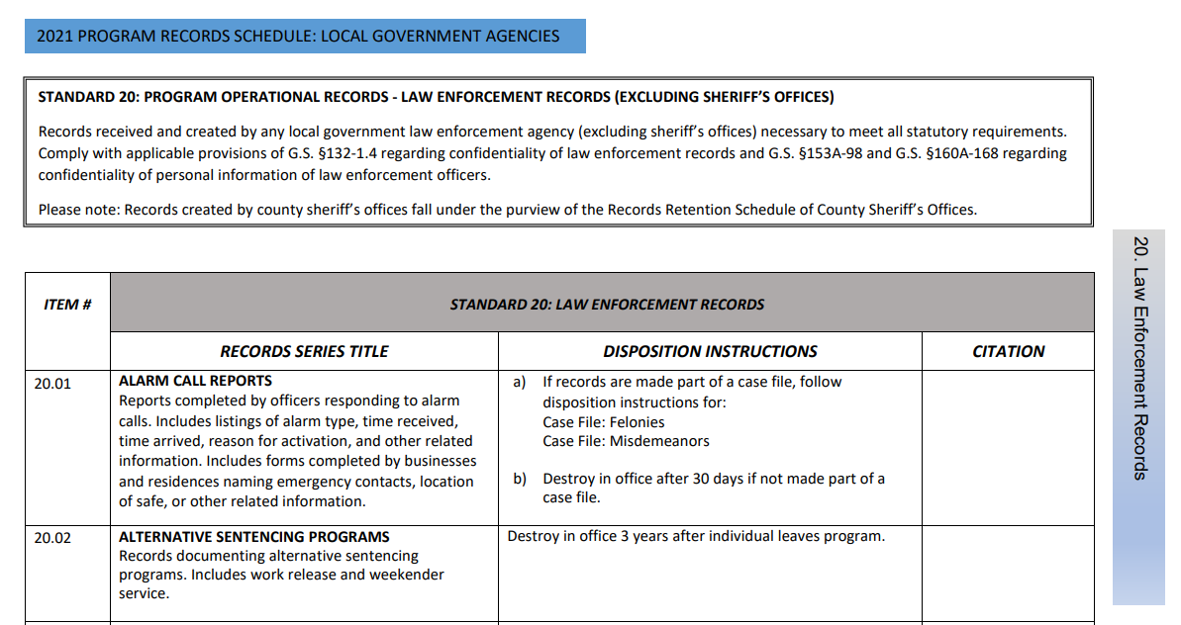
ctrl + f
Notes:
One last note, you can also search the retention schedules. They are all searchable pdfs. Control f will open a search box on a pc and you can put in a keyword.

Slide 44
Activity
Where do you think we’d find the retention information for asbestos training?
And where do you think we’d find the retention information for pool records?
Notes:
(Pull up https://archives.ncdcr.gov/government/local and walk through the process of locating the record series on the appropriate schedule. Ask participants which schedule they think we should search in first, how best to navigate, what keywords to use, etc. Try to have the participants guide your search)
Asbestos Training – General Schedule 4.06
Pool Records – Program Schedule 14.05

Slide 45
QUESTIONS?
Notes:
Questions?
(Break for 10-15 minutes)

Slide 46
Active Records
Management
Inventories and Destruction Logs
Notes:
Welcome back, everyone.
We've talked about public records law and our obligations as public employees and we’ve walked through the retention schedules that tell you what to keep and for how long. We’re going shift towards active records management now, and talk about strategies and best practices to help you can manage your digital and paper records and discourage proliferation.

Slide 47
Active Records Management is Understanding:
What You Have
Where It’s Stored
How Long You Need to Keep It
Notes:
A big part of active records management is understanding what you have, where it’s stored, and how long you need to keep it. This section is applicable to both digital and analog records, and guidance specific to electronic records will be in our next/last section.

Slide 48
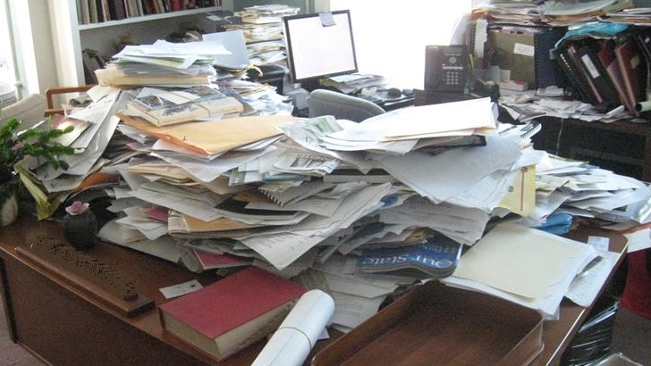
Proliferation of Records
Notes:
A proliferation, or large number, of records is a problem in a lot agencies, especially when it comes to a duplicate records and records that are eligible for destruction. I think it’s more obvious with paper records, but it’s very much an issue with electronic records as well (think about all of the emails that we receive on a daily basis).
In addition to storage concerns, it’s important to remember that if you receive a public records request for materials that COULD have been destroyed but weren’t, you are obligated to provide those records.

Slide 49
Inventory Benefits
Evaluate Usability
Eliminate Duplicates
Eligible For Destruction
Notes:
One major way to actively manage your records is to have an active and ongoing inventory. "Inventory" in this case is both an action and a tool and it becomes a resource pretty much as soon as you begin. The process allows you to:
<CLICK> gather information on the usability of the files as they currently stand
<CLICK> Eliminate duplicates & transitory records (if you discover during your inventory that you have 8000 copies of the annual report it’s ok to pull those duplicates for destruction while you’re working) AND
<CLICK> Destroy records that have met retention/ are eligible for destruction

Slide 50
Determine Inventory
Scope & Pace
2 Days Per Week
Floor By Floor
Electronic First
Paper
First
By Record Series
?
Notes:
As for how to structure your inventory approach, that’s up to you! Consider both the scope and pace to make a plan that will work for you.
Maybe you set aside a few days every week to work on the inventory. Maybe you tackle one floor at a time. You could start with your electronic files, or just paper. You could also do a record series at a time. Do what works for you, your goals, and your time restraints!

Slide 51
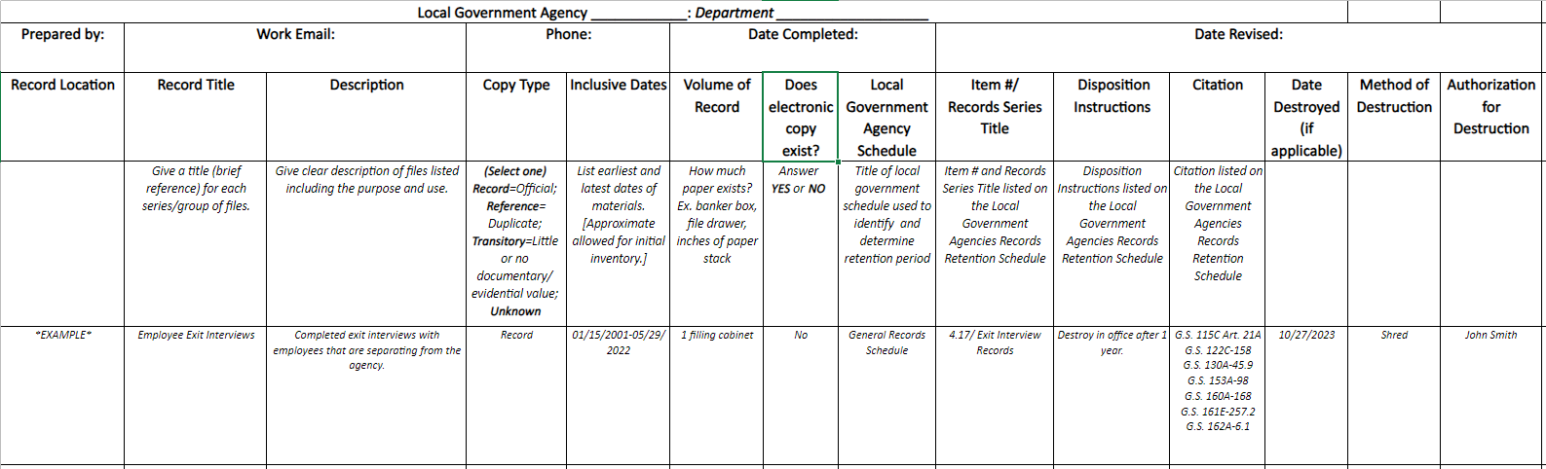
Notes:
People often assume that to inventory, you must write down every single folder.
That’s not the case. Let’s walk you through our updated inventory document
Our team created this by fusing together the file plan, inventory, and destruction log into one super tool

Slide 52
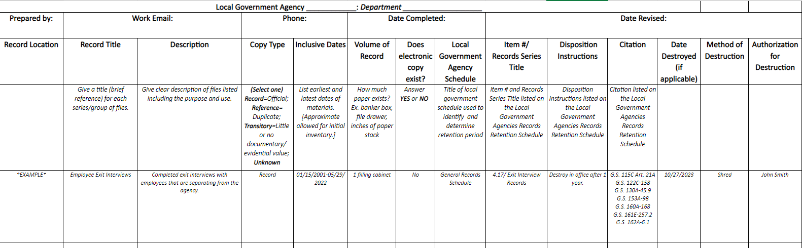
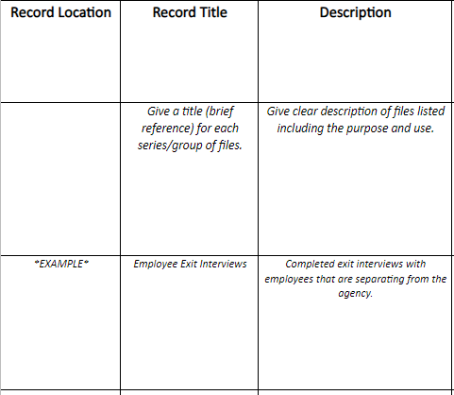
Notes:
I know this document can be hard to read I’m going to blow this up section by section.
We’ll start over here <CLICK> with “Record location. This is a good point to bring it back to our earlier point that you generally do not need to document every folder, line by line. You can document groups of similar records as long as they are housed in the same location. For example, if I have an entire file cabinet of Policies and Procedures, I would use this line to inventory that group of records. For a digital example, we can look to my records. My department shares a folder named “Workshops” on a network drive. I could specify the location of that folder by copying the file path and pasting it into the inventory
We understand that in your day-by-day in the office, you might not use the same terminology found in our retention schedules. So, in this column, you would enter a title that reflects how your team refers to this group of records.
With “Description,” we want to include a brief overview to capture the purpose and use of the documents and observations on their arrangement/organization

Slide 53
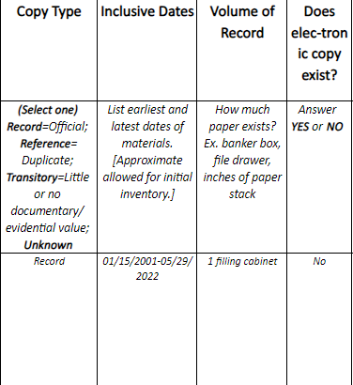
Notes:
Here we document what type of copy we’re looking at. Record Copy, Reference Copy, Transitory Record, or Unknown
Inclusive dates are the earliest and latest dates of the materials; approximate dates are fine for an initial inventory
An estimated volume works here. 7 drawers? 3 feet of folders? 6GB?
Here we’d just indicate if a digital copy exists with a Yes/No

Slide 54
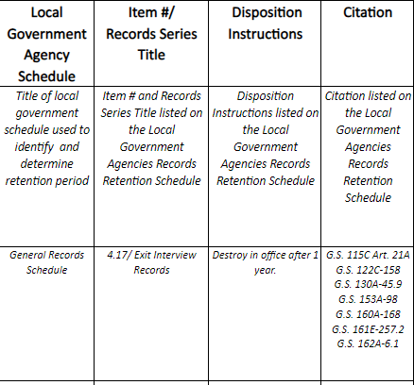
Notes:
In this section we start to reconcile/connect how your agency refers to the records and how they’re classified on the appropriate retention schedule.
For example, earlier I referred to a digital folder titled, “Workshops.” That term is not how the retention schedule would refer to it but it works for our team.
But at this point, I’d find the appropriate record schedule and enter it <CLICK> here.
I’d then find the item number and record series title and enter those details <CLICK> here. You may even find that your inventory includes multiple names for records that all match the same series on the retention schedule. documenting this in your inventory will make it easier to find and destroy the files that have met their retention.
And while the retention schedule is open to the series, you would want to write down the <CLICK> disposition instructions…
And <CLICK> any citation included on the retention schedule for that series

Slide 55
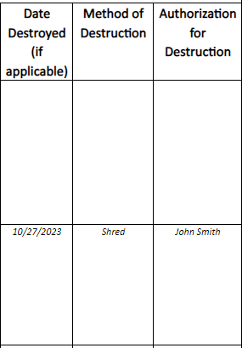
Notes:
Finally, this is where you could begin to turn your inventory into a Destruction Log.
<CLICK> Date Destroyed is the date of destruction.
<CLICK> Method of Destruction - Here you would note if the materials were shredded, burned, pulped, and turned into paper towels
<CLICK> And in this column we enter the name of the person who is authorizing the destruction. Sometimes this is the Clerk, the Records Liaison, the manager, or the person destroying the record. It’s up to your agency to determine which individuals will authorize this step.

Slide 56
Defensible Destruction
What Was Destroyed
When
Method of Destruction
Authorization
Notes:
You heard me mention that this document can serve as your destruction log.
Maintaining a destructions log is a best practice required by law, and you’ve already set your agency up to document which records were destroyed, when they were destroyed, how they were destroyed, and who authorized their destruction. ​
If you get a public records request for records that have been destroyed, you can back up their destruction with this log.

Slide 57
QUESTIONS?
Notes:
Any questions about inventories and destructions logs?

Slide 58
Electronic Records
Notes:
For our last section of this workshop, we’re going to focus specifically on electronic records.

Slide 59







Notes:
While records management considers all records regardless of format, there are some unique considerations for electronic files due to their digital nature.
It’s important to note that YOU are the one responsible for ensuring that your electronic files are managed properly and in accordance with records retention schedules.

Slide 60
Create Trustworthy
Electronic Records
Created during the course of normal business
As part of established office procedures
Using policies and procedures for system development, maintenance, and use
With proper audit trails
Notes:
You want to make sure that you are creating trustworthy electronic records. This means that the records are created during the course of normal business, as part of established office procedures, using policies and procedures for system development, maintenance, and use, and that the records have proper audit trails

Slide 61
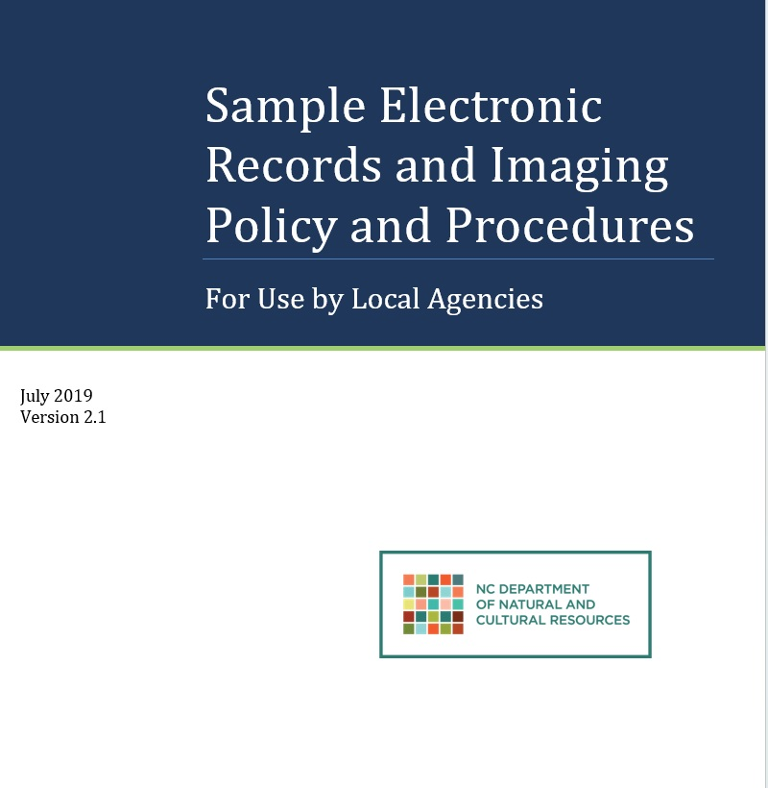
https://bit.ly/SANC-EREC
Notes:
One way to ensure that you are creating trustworthy electronic records is through the creation of and adherence to an electronic records policy. We have an excellent resource/sample policy on our website to support your work in managing trustworthy electronic records. You can adapt any language and format from the sample document, and we’re here to help provide guidance/feedback on your policy.
It is important to note that if you plan to scan records and destroy the original paper copy, you must have an electronic records policy in place and that policy must be approved by State Archives. Please feel free to reach out to analyst for more information about this process.
For today, we’ll focus on…

Slide 62
File Naming
Organization
Storage
Notes:
….a few tips to help effectively manage your electronic records, including <CLICK> for implementing consistent file naming, <CLICK> logical file organization, <CLICK> and appropriate use of electronic storage.

Slide 63
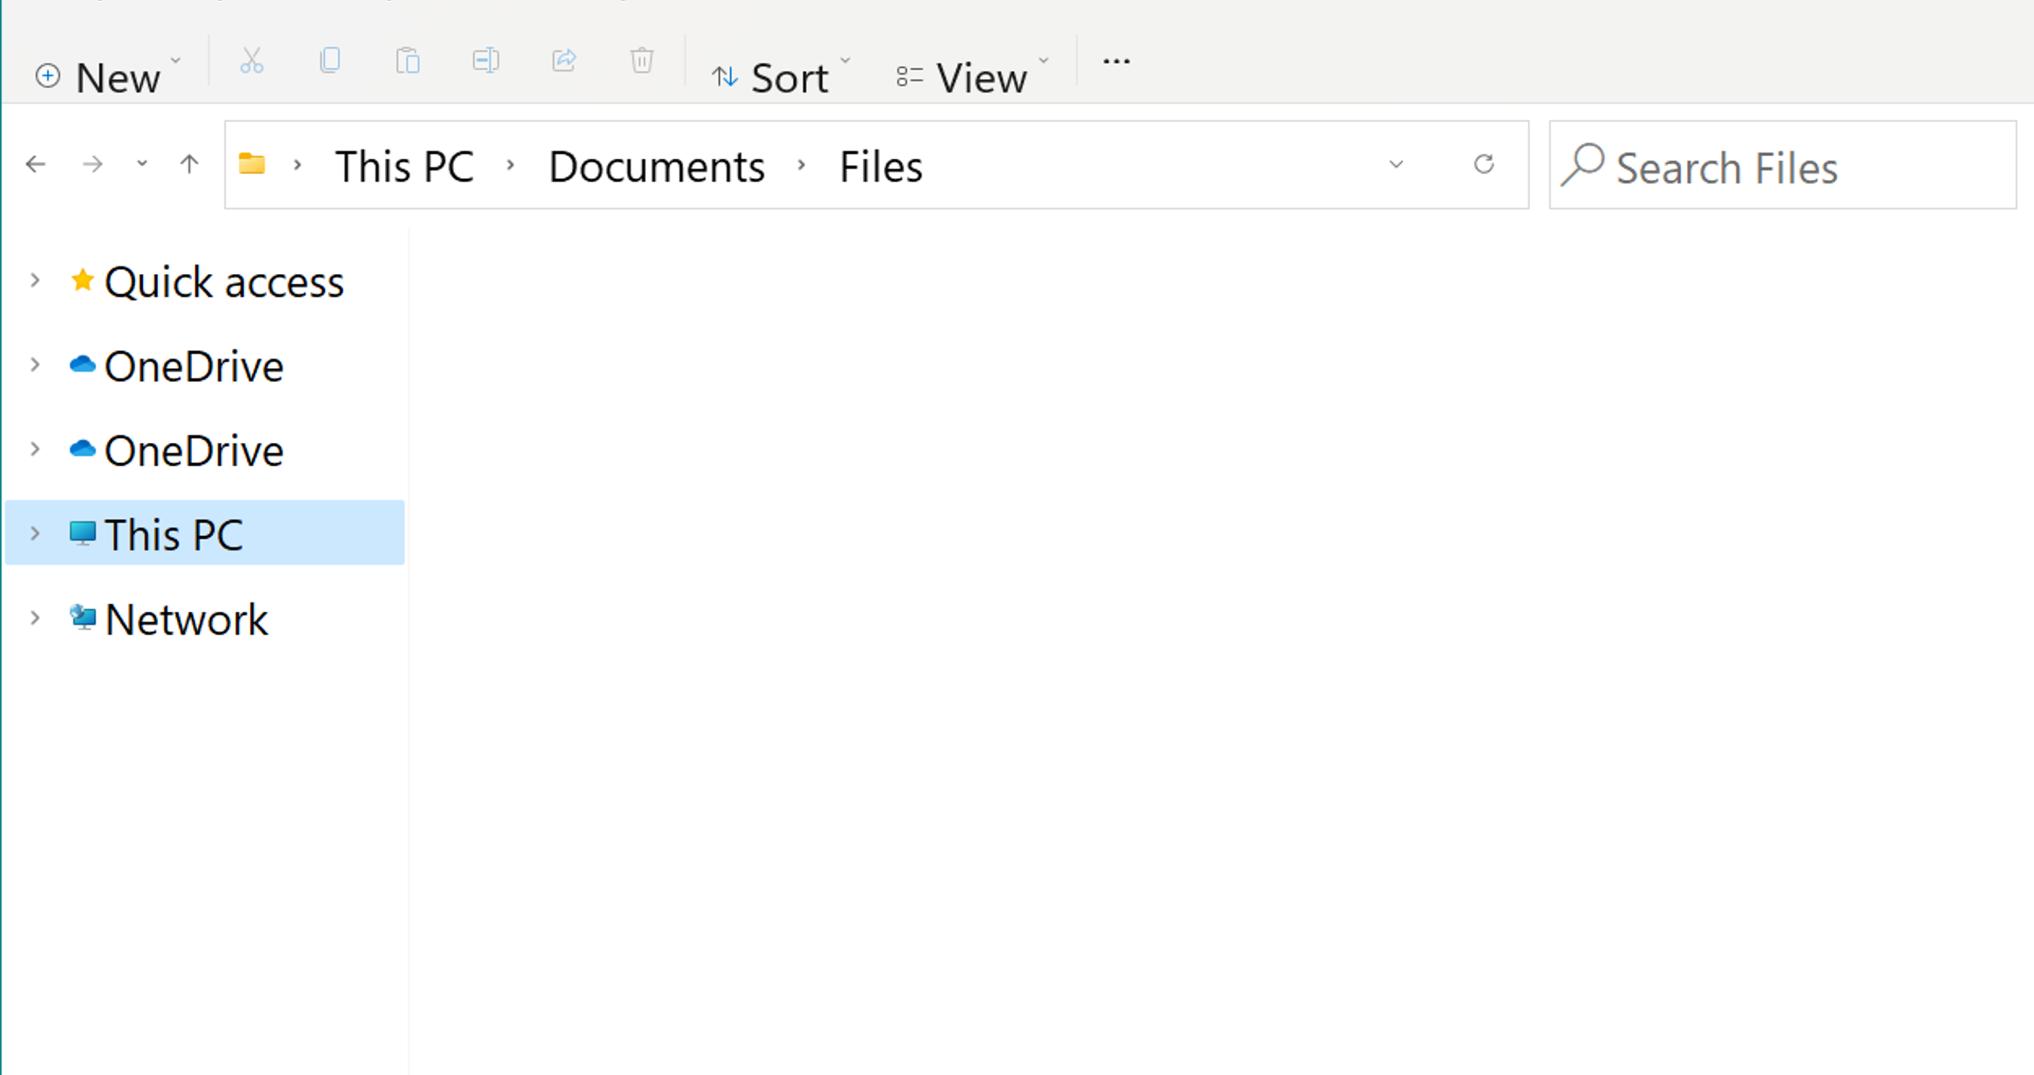



final report – Copy(2)
Form NEW
graphs.for.report
form data from last year
Meeting notes
slides.from.staff.meeting
final report #2 comments
report draft1
Notes:
By using descriptive and consistent naming conventions for your electronic files...

Slide 64
Report_v2_Final
Form_2024
Report_Graphs
Form-Data_2023
StaffMeeting_Notes_20240120
StaffMeeting_Slides_20240120
Report_v2_Comments
Report_v1_Draft
Notes:
...you can more easily identify your documents and their contents without having to open them.
Since it’s very easy to unintentionally modify digital files, reopening an inactive record might make it active again, which could impact its retention period.

Slide 65
File-Naming Best Practices
Brief
Descriptive
Date
Version
Notes:
It is best practice to incorporate the following elements within a file name:
<CLICK> A title that succinctly describes the document’s content,
<CLICK> The date of creation or modification,
<CLICK> And a version or draft number.
When naming a file, you should ask yourself: would a future colleague be able to determine what this document is based off the filename alone?

Slide 66


Acceptable Special Characters
Special Characters To Avoid
\ / : ; * ^ # ? ! “ ” < > , .
Dashes ( - )
Underscores ( _ )
% | [ ] { } ( ) & $ ~ @ ` ‘
Notes:
You should also avoid using special characters as they can increase the chance of the computer misreading the file. Spaces within filenames can also cause issues.
Use underscores and dashes instead! For readability you can also try camel case, where you capitalize the first letter of every word.

Slide 67
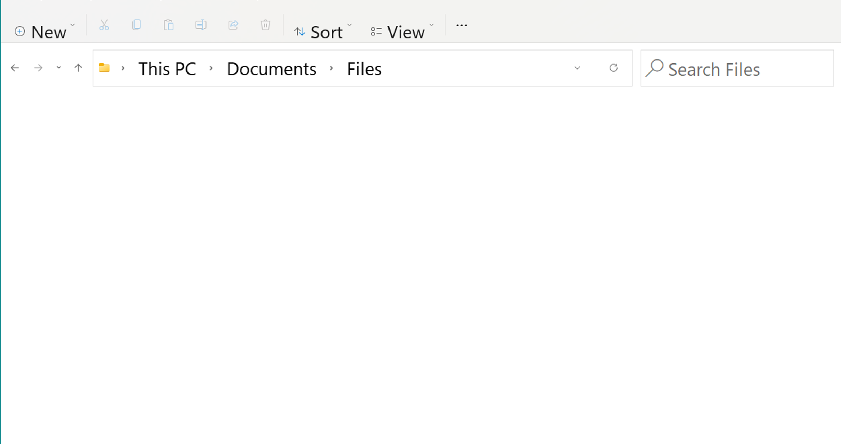




Documents
MonthlyReports
2020 Reports
2021 Reports
202301_Report
202302_Report
202303_Report
2022 Reports
2023 Reports
2024 Reports
Trainings
Presentations
202304_Report
202305_Report
202306_Report
Notes:
Additionally, logical organization of folders and files can make it much easier to locate records. Don’t rely on the search function! That only works if you remember what you named the file in the first place.
Again, consider future colleagues when setting up a file system, especially on a shared drive.

Slide 68
C:\Users\user\Documents
\Folder
\Folder
\Folder
\Folder
\Folder
Folder
Folder
Folder
Notes:
You do want to avoid deeply-nested folder hierarchies, however, as they increase the chances of misplacing and unnecessarily duplicating files.

Slide 69

C:\Users\user\Documents
\Folder
\Folder
\Folder
\Folder
\Folder
\Folder
Folder
Folder
Folder
Error: Cannot Open File
C:\User\user\Documents\Folder\Folder\Folder\Folder\Folder\Folder\File
Notes:
Lengthy file paths <CLICK> may cause technical issues as well. Oftentimes this won’t be apparent until you try to migrate files.

Slide 70
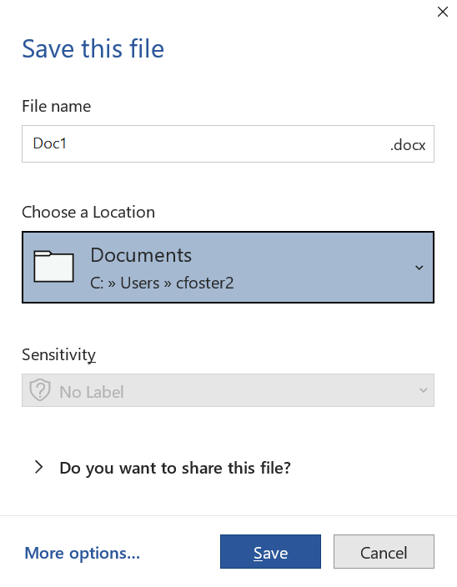

Notes:
Lastly, you want to make sure that you are saving your files <CLICK> to the appropriate location.

Slide 71



Notes:
Most organizations offer shared storage that allow for multiple users to access simultaneously. These shared environments can be restricted to specific groups or made available to the entire organization.
You should consider who does and does not need access to a particular document when selecting its storage.

Slide 72



Personal
Workgroup
Organizational
  Relevant To
  You Only
  Can Be Shared With Workgroup
  Can Be Shared With Entire Organization
Notes:
A draft of a document that’s not ready for sharing might be best on your personal drive so that it doesn’t clutter a shared space.
Documents related to a project within a specific workgroup might not need to be accessible to everyone in the organization, and so would best be stored on the workgroup's drive.
However, projects spanning several workgroups might need to be in organization-wide shared storage.

Slide 73
PLAN FOR SUSTAINABILITY
Never trust claims that you won’t have to actively manage electronic records over time​
Anticipate changes to the underlying hardware and software
Periodically sample records to ensure that they’re still readable and not corrupted
Notes:
One final thing to remember with electronic records is that you must always plan for sustainability – both internally and with vendor records. Never trust claims from vendors that you won’t have to actively manage records over time. Recognize that hardware and software are going to change, and make sure that you have a way to get your records out of proprietary or vendor-based systems.​
Who has a PC or laptop without a CD Drive?​ And Who remembers Lotus 1-2-3 and WordStar? ​
Finally, active management also means checking on these files periodically to make sure that they are still accessible – that all of the technology required to read that file is still working properly, and the media on which the files are stored is still readable.​

Slide 74
In Review:
Consistent File Naming
Logical Organization
Appropriate Storage Location
Plan for Sustainability
Notes:
In review, to help you effectively manage your electronic files, you should:
<CLICK> Consistently follow file naming best practices,
<CLICK> Organize folders logically,
<CLICK> save files to the appropriate location for their purpose, use, and intended access to others
<CLICK> and plan for sustainability.

Slide 75




State Archives Records Analysis Unit
?
Notes:
Remember, as a public employee, records management is your responsibility, but you’re not alone! The State Archives has a lot of resources to help you.

Slide 76
QUESTIONS?
Notes:
Any final questions?

Slide 77
Records Analysis Unit recordsmanagement@dncr.nc.gov
Mark Holland, Supervisor mark.holland@dncr.nc.gov (919) 814-6908 | Evanna Derkach evanna.derkach@dncr.nc.gov (919) 814-6829
Francesca Evans francesca.e.evans@dncr.nc.gov (919) 814-6918 | Flannery Fitch, Appraisal Archivist flannery.fitch@dncr.nc.gov (919) 814-7066
Corinne Foster corinne.foster@dncr.nc.gov (919) 814-6932 | Natalie Walker natalie.walker@dncr.nc.gov (919) 814-6856
Kayla Leonard, Essential Records Analyst Eastern Region (New Bern) kayla.leonard@dncr.nc.gov (252) 639-3543 | Jason Woolf Western Region (Asheville) jason.woolf@dncr.nc.gov (828) 250-3103
Notes:
Here is our contact information if you ever have record management questions. This is also included on the handout.
______ will share the link to our survey in the chat. If you would like to request a certificate of attendance you will need to click through the survey. Kayla will send out the link in a follow-up email.
Thanks for joining us today!

